Slide 1
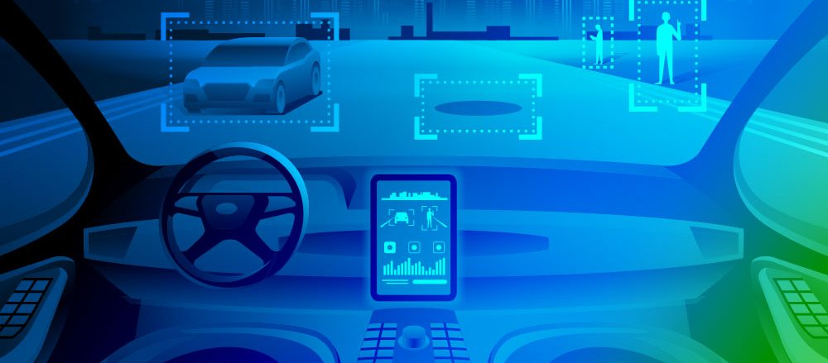
Autonomous Vehicle
ECEN 5763 – Embedded Machine Vision and Intelligent Automation
By Vatsal Sheth & Amreeta Sengupta

Slide 2
Functional Capabilities
SYSTEM CAPABILITIES
LANE DEPARTURE WARNING SYSTEM
PEDESTRIAN DETECTION AND WARNING
TRAFFIC SIGN DETECTION AND WARNING
VEHICLE DETECTION AND WARNING

Slide 3
Lane Detection
Convert to Gray scale
Crop Frame
Canny Edge Detection
Apply Mask on frame
Probabilistic Hough Transform
For all detected lines: Calculate slope and club valid lines
Mark lanes on original frame with offset
Lane Departure Warning based on lane line intersection and image mid-point (Not Tested)

Slide 4
Vehicle Detection
Convert to Gray scale
Crop Frame
Resize image to 50%
Cascade classifier to detect car.
Draw bounding rectangle on original frame based on scale and offset

Slide 5
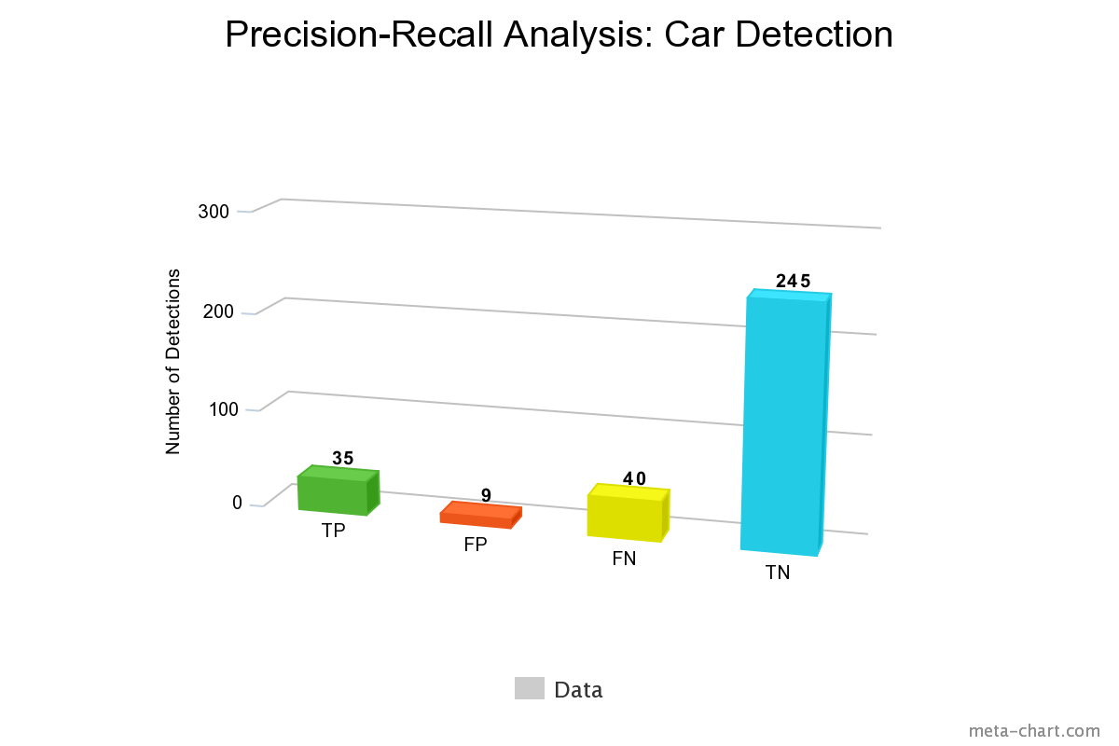

Analysis
$Accuracy=\frac{TP+TN}{Total}=0.85$
$Precision=\frac{TP}{TP+FP}=0.79$
$Recall=\frac{TP}{TP+FN}=0.46$
$F1=2∗\frac{precision∗recall}{precision+recall}=0.58$

Slide 6
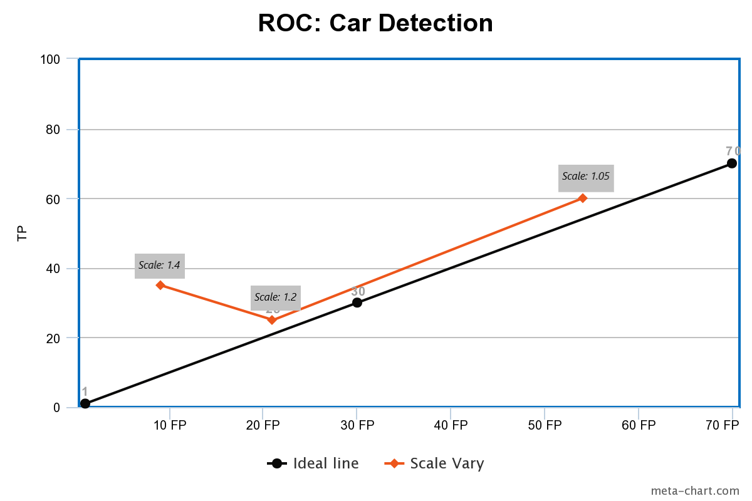
ROC: Car Detection
This curves shows variation in TP and FP values with changing scale parameter in detectMultiScale() API
This parameter defines the step size for scale pyramid in sliding window Haar cascade detector

Slide 7
Pedestrian Detection
Convert to Gray scale
Resize image to 50%
HOG descriptor to detect pedestrian using default people descriptor in OpenCV
Draw bounding rectangle on original frame
Notes:
Detectmultiscale API parameter
Min size
Scale: resolution for change in scale pyramid. Trade off. Works best if we know the XML is trained for what scale objects.
Min neighbor: sliding window look matching descriptor from xml. Next iteration, it will scale and do again. So many false positives. To solve this, use this parameter. It says if a rectangle has this many neighbor rectangles then only consider it. If we use too large value then false negatives will increase.

Slide 8
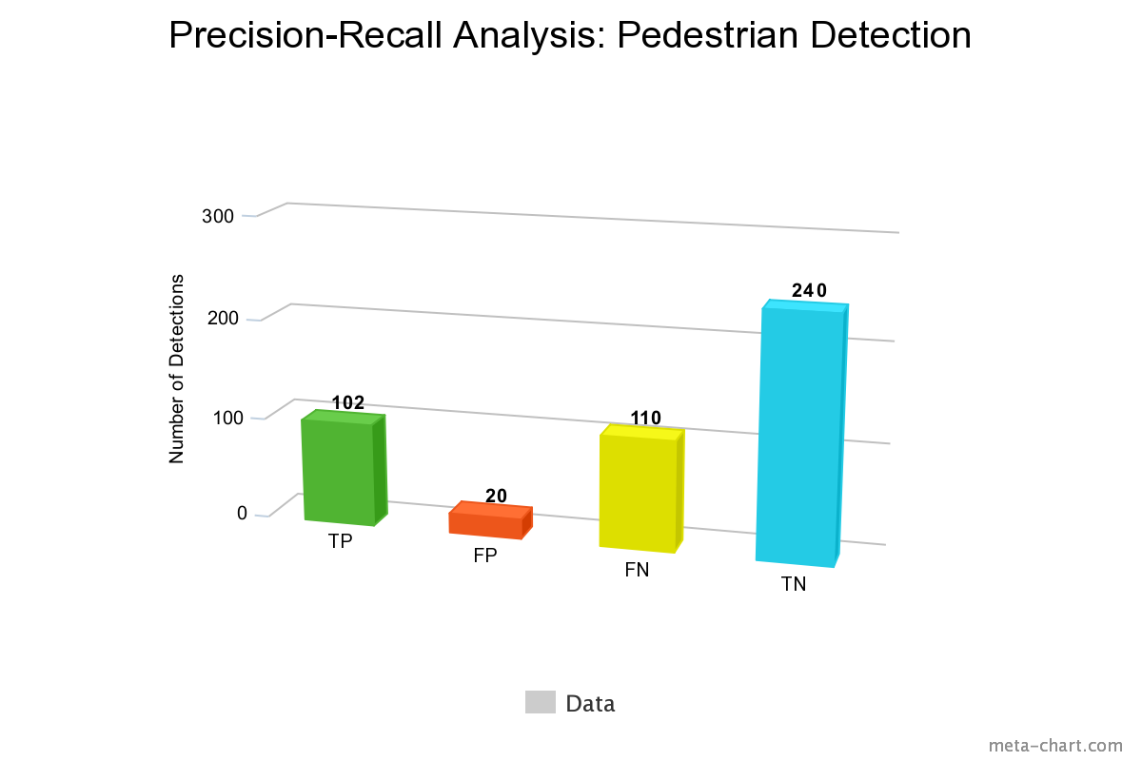

Analysis
$Accuracy=\frac{TP+TN}{Total}=0.72$
$Precision=\frac{TP}{TP+FP}=0.83$
$Recall=\frac{TP}{TP+FN}=0.48$
$F1=2∗\frac{precision∗recall}{precision+recall}=0.61$

Slide 9
Traffic Light Detection
Convert to Gray scale
Resize image to 50%
Cascade classifier to detect Traffic Light
Draw bounding rectangle on original frame based on scale

Slide 10
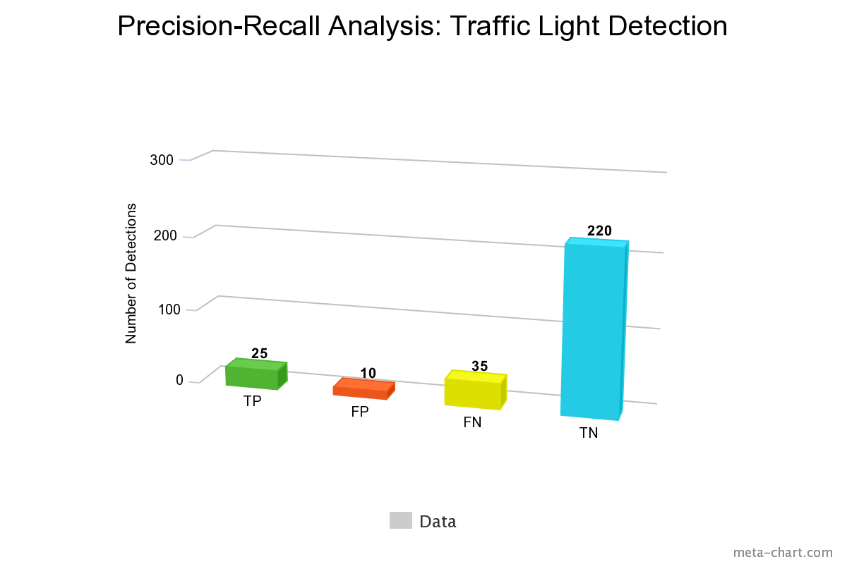

Analysis
$Accuracy=\frac{TP+TN}{Total}=0.82$
$Precision=\frac{TP}{TP+FP}=0.71$
$Recall=\frac{TP}{TP+FN}=0.41$
$F1=2∗\frac{precision∗recall}{precision+recall}=0.52$

Slide 11
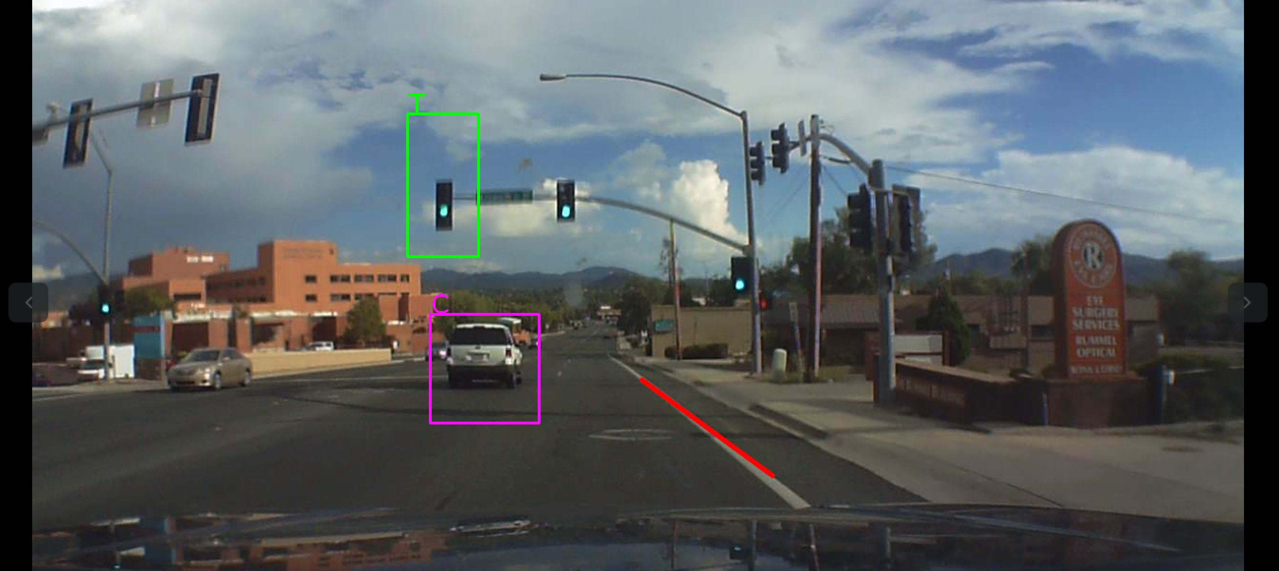

Slide 12
GPU
Using NVIDIA CUDA library instead of OpenCV or use GPU library of OpenCV which uses implementation based on CUDA
Detection Performance for GPU library is poor as OpenCV has not updated it
8x Speedup claimed by Nvidia for cascade detection with GPU library
2.5x actual speedup achieved
Limitation of time for CPU to GPU memory transfer of input frame and GPU to CPU memory transfer of output frame

Slide 13
Multi-threading
Concept of Pipeline from Computer Architecture
Each thread tied to a specific core
Each thread performs all detection operations so, effectively four frames computed simultaneously
Frame skipping based on frame number and retain previous detection
Advantage in CPU utilization over each thread doing specific function multi-threading concept

Slide 14
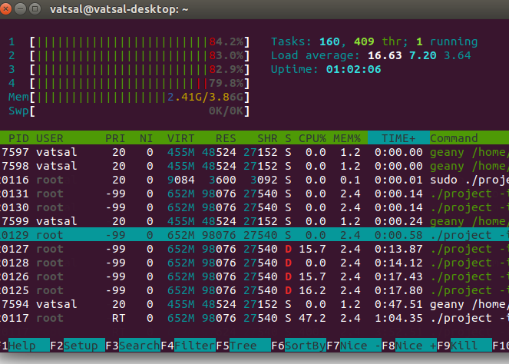
CPU Performance

Slide 15
Frame Rate Analysis
Half HD Video [1280X640]
Implementation Approach | FPS
Without Frame Skipping | 5.08
With Frame Skipping | 12.46
Detections | FPS
 | WITHOUT FRAME SKIPPING | WITH FRAME SKIPPING
Lane Detection | 11.20 | 14.14
Pedestrian Detection | 4.78 | 12.87
Traffic Light Detection | 8.18 | 16.05
Car Detection | 9.10 | 15.49
Video [640x480]
Implementation Approach | FPS
Without Frame Skipping | 16.67
With Frame Skipping | 33.84

Slide 16
Project Proposal Specifications
Minimum Goals
Perform lane detection with more than 50% accuracy.
Perform pedestrian detection with more than 50% accuracy.
Perform car detection with more than 50% accuracy.
Perform traffic light detection with more than 50% accuracy.
Target Goals
Implement a Lane Departure Warning System.
Implement pedestrian detection algorithm with an accuracy of more than 70%.
Implement car detection algorithm with an accuracy of more than 70%.
Implement traffic light detection algorithm with an accuracy of more than 70%.
Warning the driver incase pedestrian is detected on the road by annotating the output frames with appropriate message.
Time measurement and frame rate measurement for real-time performance analysis.

Slide 17
Optimal Goals
Pthread library for multithreading will be used to optimize the performance. There will be 5 threads in total, 4 threads for each feature and one for capturing frame and computing common tasks like converting to gray scale. Inter process communication or signals will be used to schedule feature threads by frame capture thread.
Lane Detector algorithm achieves optimization by cropping the image to half. As road will always be below the horizon so, it is safe to cut the image into half to save execution time. To minimize the line detection for Hough Transform, Triangular ROI mask will be used. This mask will basically extract only the part of image which has road and neighboring lanes. Slope based filtering will be done to separate left and right lane lines and draw only one line for each side.
Basic learning of CUDA and try to integrate it in this project.
Profiling of each task will be done based on time measurements and further scheduling optimizations will be considered if possible.
Feature detection is most time expensive task. Car, road sign, pedestrian detection is not required to be performed on all frames continuously. Pedestrian will be performed for example once for every 3 frames and road sign and vehicle every 5 frames. This will effectively increase these tasks deadline. Based on profiling then appropriate statics scheduling policy like Rate Monotonic will be chosen.

Slide 18
We were able to achieve all our minimum goals.
From the target goals we were able to implement pedestrian detection, car detection, traffic light detection algorithms with more than 70% accuracy.
For pedestrian detection, we annotated the video frames with a “Slow Down” warning message.
From the optimal goals, we did everything.
We tried implementation using CUDA. We could either use NVIDIA CUDA library instead of OpenCV or we could use GPU library of OpenCV which uses implementation based on CUDA. However, detection performance for GPU library was poor as OpenCV has not updated it. NVDIA claimed to give 8x Speedup for cascade detection with the use of GPU library. However, only 2.5x speedup was actually achieved. This could be because CPU to GPU memory transfer of input frame and GPU to CPU memory transfer of output frame are time consuming. Hence, we decided to use multi-threading approach for our implementation.

Slide 19
THANK YOU!

